Slide 1
The business vision and mission
Chapter 4
Sep 14th, 2019
Miami Dade College

Slide 2
The main questions
Where are we now?
Where do we want to go?
How are we going to get there?

Slide 3
Introduction
What Do We Want to Become?
A vision statement should answer the basic question, “What do we want to become?”
The vision statement should be short, preferably one sentence,
As many managers as possible should have input into developing the statement.
Clear vision and mission statements can benefit other strategic-management activities.

Slide 4
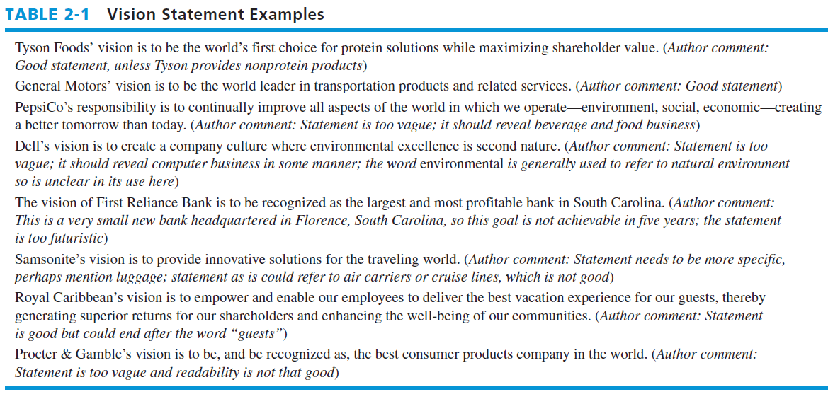
Vision Statement Examples
Problems:
Too vague statement
Too futuristic
Too long
Business context is not clear
Not clear terms
Readability issues

Slide 5
What Is Our Business?
Mission statement
A declaration of an organization’s “reason for being.”
Answers the pivotal question “What is our business?”
Essential for effectively establishing objectives and formulating strategies

Slide 6
Mission Statement
Mission statement
  Reveals what an organization wants to be and whom it wants to serve
  Also called
  A creed statement,
  A statement of purpose,
  A statement of philosophy,
  A statement of beliefs,
  And a statement of business principles

Slide 7
Vision and Mission
Shared vision creates a commonality of interests
Can lift workers out of the monotony of daily work and
Put them into a new world of opportunity and challenge.

Slide 8
The Process of Developing Vision and Mission Statements
Select several articles about these statements and ask all managers to read these as background information.
Ask managers themselves to prepare a vision and mission statement for the organization.
Merge these statements into a single document and distribute the draft statements to all managers
Process should create an “emotional bond” and “sense of mission” between the organization and its employees

Slide 9
Importance of Vision and
Mission Statements
To ensure unanimity of purpose within the organization
To provide a basis, or standard, for allocating organizational resources
To establish a general tone or organizational climate
To serve as a focal point for individuals to identify with the organization’s purpose and direction
To facilitate the translation of objectives into a work structure
To specify organizational purposes

Slide 10
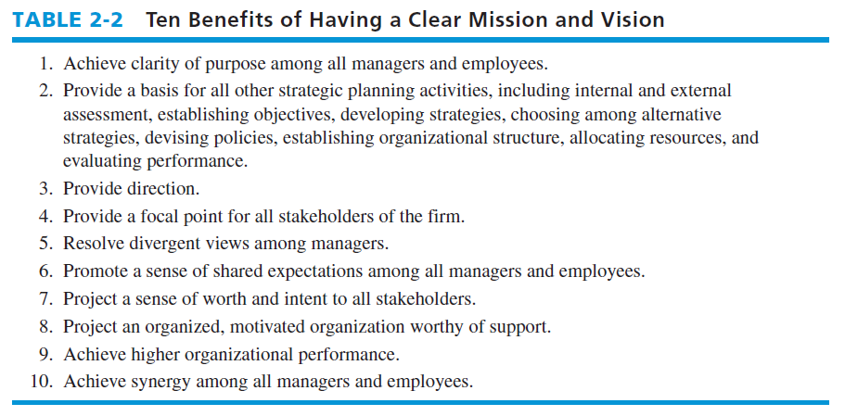
Benefits of Having a Clear Mission and Vision

Slide 11
Characteristics of a Mission Statement
First, a good mission statement allows for the generation and consideration of a range of feasible alternative objectives and strategies without unduly stifling management creativity.
Second, a mission statement needs to be broad to reconcile differences effectively among, and appeal to, an organization’s diverse stakeholders
Stakeholders
Include employees, managers, stockholders, boards of directors, customers, suppliers, distributors, creditors, governments (local, state, federal, and foreign), unions, competitors, environmental groups, and the general public.

Slide 12
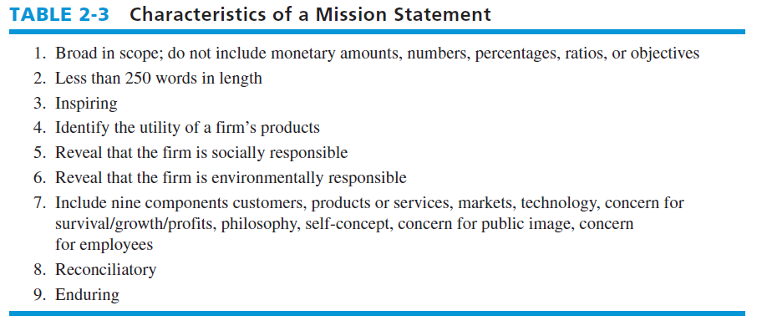
Continued…

Slide 13
A Customer Orientation
A mission statement should:
Define what the organization is and what the organization aspires to be
Be limited enough to exclude some ventures and broad enough to allow for creative growth
Distinguish a given organization from all others
A mission statement should also:

Slide 14
Continued…
Serve as a framework for evaluating both current and prospective activities
Be stated in terms sufficiently clear to be widely understood throughout the organization
A good mission statement reflects the anticipations of customers.
The operating philosophy of organizations should be to identify customers’ needs and then provide a product or service to fulfill those needs.

Slide 15
Mission Statement Components
1. Customers—Who are the firm’s customers?
2. Products or services—What are the firm’s major products or services?
3. Markets— Geographically, where does the firm compete?
4. Technology— Is the firm technologically current?
5. Concern for survival, growth, and profitability— Is the firm committed to growth and financial soundness? (i.e.: for investors)
6. Philosophy—What are the basic beliefs, values, aspirations, and ethical priorities of the firm?

Slide 16
Continued…
7. Self-concept— What is the firm’s distinctive competence or major competitive advantage?
8. Concern for public image— Is the firm responsive to social, community, and environmental concerns?
9. Concern for employees— Are employees a valuable asset of the firm?

Slide 17
Example Mission Statements
We aspire to make PepsiCo the world’s (3) premier consumer products company, focused on convenient foods and beverages (2). We seek to produce healthy financial rewards for investors (5) as we provide opportunities for growth and enrichment to our employees (9), our business partners and the communities (8) in which we operate. And in everything we do, we strive to act with honesty, openness, fairness and integrity (6).

Slide 18
Example Mission Statements
Dell’s mission is to be the most successful computer company (2) in the world (3) at delivering the best customer experience in markets we serve (1). In doing so, Dell will meet customer expectations of highest quality; leading technology (4); competitive pricing; individual and company accountability (6); best-in-class service and support (7); flexible customization capability (7); superior corporate citizenship (8); financial stability (5).

Slide 19
Example Mission Statements
Procter & Gamble will provide branded products and services of superior quality and value (7) that improve the lives of the world’s (3) consumers. As a result, consumers (1) will reward us with industry leadership in sales, profit (5), and value creation, allowing our people (9), our shareholders, and the communities (8) in which we live and work to prosper.

Slide 20
A test
Fleetwood Enterprises will lead the recreational vehicle and manufactured housing industries (?, ?) in providing quality products, with a passion for customer-driven innovation (?). We will emphasize training, embrace diversity and provide growth opportunities for our associates and our dealers (?). We will lead our industries in the application of appropriate technologies (?). We will operate at the highest levels of ethics and compliance with a focus on exemplary corporate governance (?). We will deliver value to our shareholders, positive operating results and industry-leading earnings (?).

Slide 21
A test
We are loyal to Royal Caribbean and Celebrity and strive for continuous improvement in everything we do. We always provide service with a friendly greeting and a smile (?). We anticipate the needs of our customers and make all efforts to exceed our customers’ expectations (?). We take ownership of any problem that is brought to our attention. We engage in conduct that enhances our corporate reputation and employee morale (?). We are committed to act in the highest ethical manner and respect the rights
and dignity of others. (?).

Slide 22
A test
At L’Oreal, we believe that lasting business success is built upon ethical (?) standards which guide growth and on a genuine sense of responsibility to our employees (?), our consumers, our environment and to the communities in which we operate (?).

